Slide 1

DES Project
Team 3

Slide 2
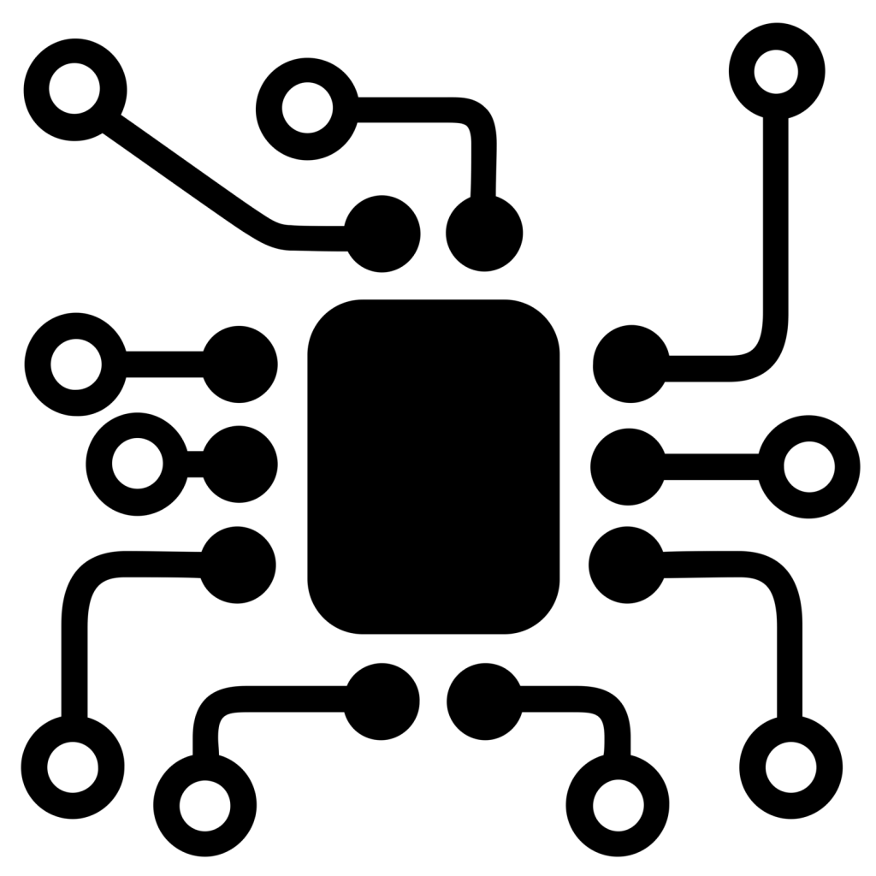
CONTENTS
Structure
01
Circuit Diagram
02
CAN
03
DES
INSTRUMENT
CLUSTER
Rpi Processes
04
GUI Application
05

Slide 3
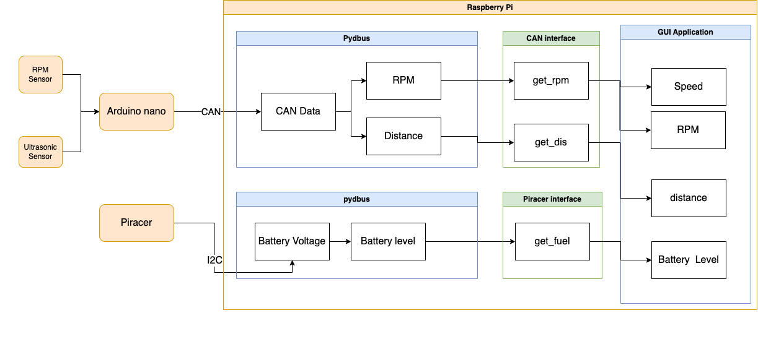
Structure
ECU
Processor
D bus

Slide 4
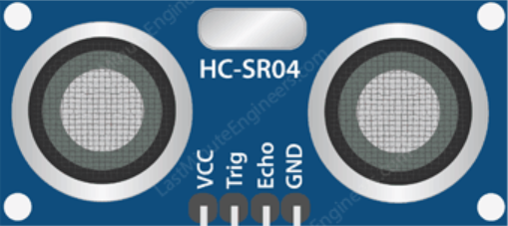
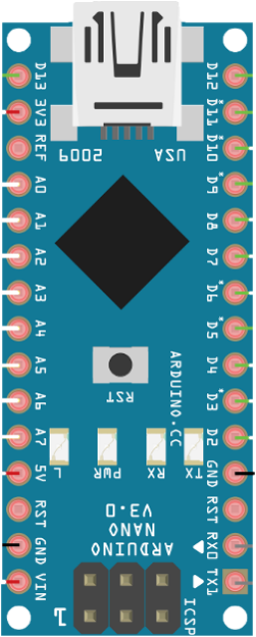
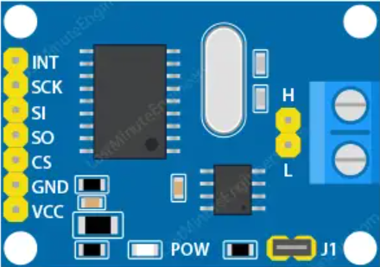
Circuit Diagram
Role of each pin
RPM Sensor
The 5V voltage is used to power and operate within electronics.
5V
Ultrasonic Sensor
GND
GND serves as the electrical reference point in electronic devices.
GND
DO
VCC
AO
D1
It is used to receive and send input and output signals of sensors.
CAN High
CAN Low
Arduino Nano
CAN Module

Slide 5
How to connect CAN?
Arduino CAN connection
Arduino ide and basic configuration must be completed.
Step 01
Step 02
Step 03
Step 04
Install CAN Library
Set Frequency
Connect with CAN shield
Set Bitrate
Every ECU have to set same bitrate
The frequency is set according to the shield
Connect the correct pin number and CAN H, L
We choose autowp-mcp2515
Preparation for CAN communication with Arduino is finish!

Slide 6
How to connect CAN?
RPi CAN connection
RPi OS and basic configuration must be completed.
Step 01
Step 02
Step 03
Step 04
Enable I2C interface
Install libraries
modify config.txt
Set bitrate and Frequency
Choose Interfacing Options -> I2C -> Yes.
Install BCM2835, Wiring Pi, python-can
The process of setting the pin number of RPi
Same way as arduino
If the connection is complete, check it with candump

Slide 7
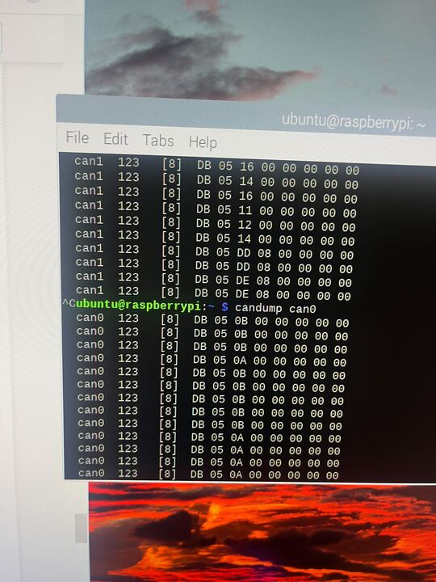
What data is sent by CAN?
CAN Data Sent from Arduino
In Raspberry Pi
This data is received from Arduino
The two sensor data are stored and transmitted in CAN Data field respectively.
Ultrasonic sensor
RPM sensor
Send distance data
Send RPM data
Stored in bytes CAN Data Field so [0] [1]
Stored in bytes CAN Data Field so [2] [3]
CAN Data Field

Slide 8
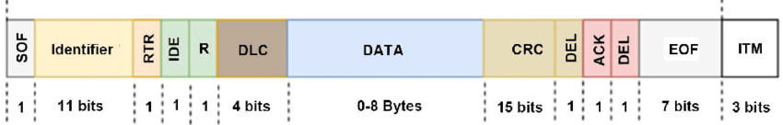
CAN Data Frame
Distance % 256 | Distance / 256 | RPM % 256 | RPM / 256 | 0 | 0 | 0 | 0
Distance : data[0] + data[1]*256
RPM : data[2] + data[3]*256
Data exceeding 8 bits can be transformed in this way.

Slide 9
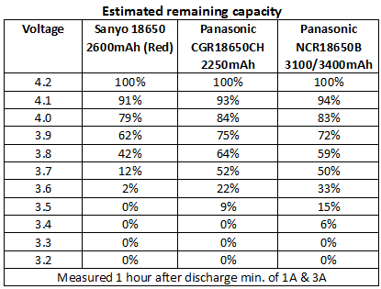
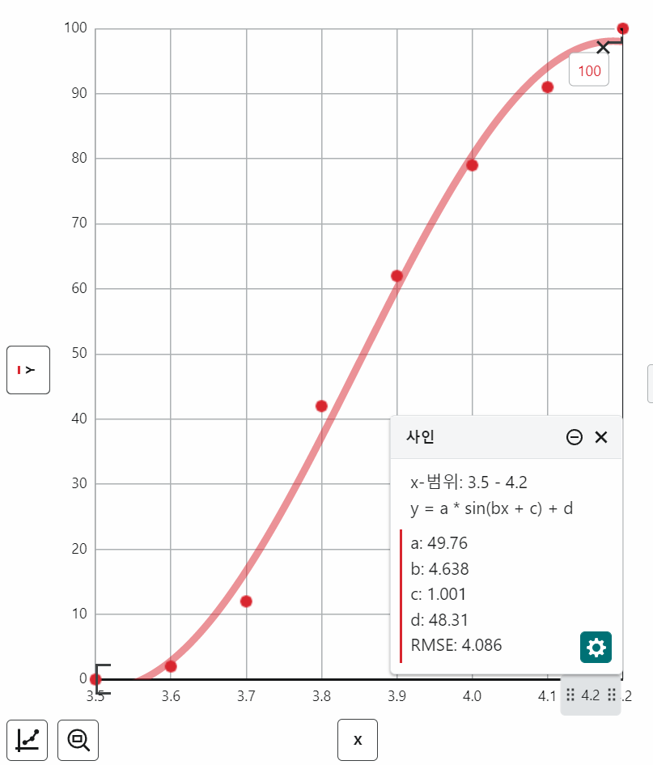
Battery Indicator
How to transfer battery voltage to battery level?
We perform regression analysis on each set of data to estimate the values using a sin function
Regression
Battery Level = 0.498 * sin(1.546*Voltage + 1.001) + 0.48

Slide 10
Processes
Responsibilities
Session Bus
Dashboard
Fetch data that needs to be displayed
Display it to user in GUI
CAN Receiver
Fetch RPM, distance data from CAN Bus
Provide interface and methods to DBus
PiRacer Controller
Control and monitor PiRacer vehicle
Provide interface and methods to DBus

Slide 11
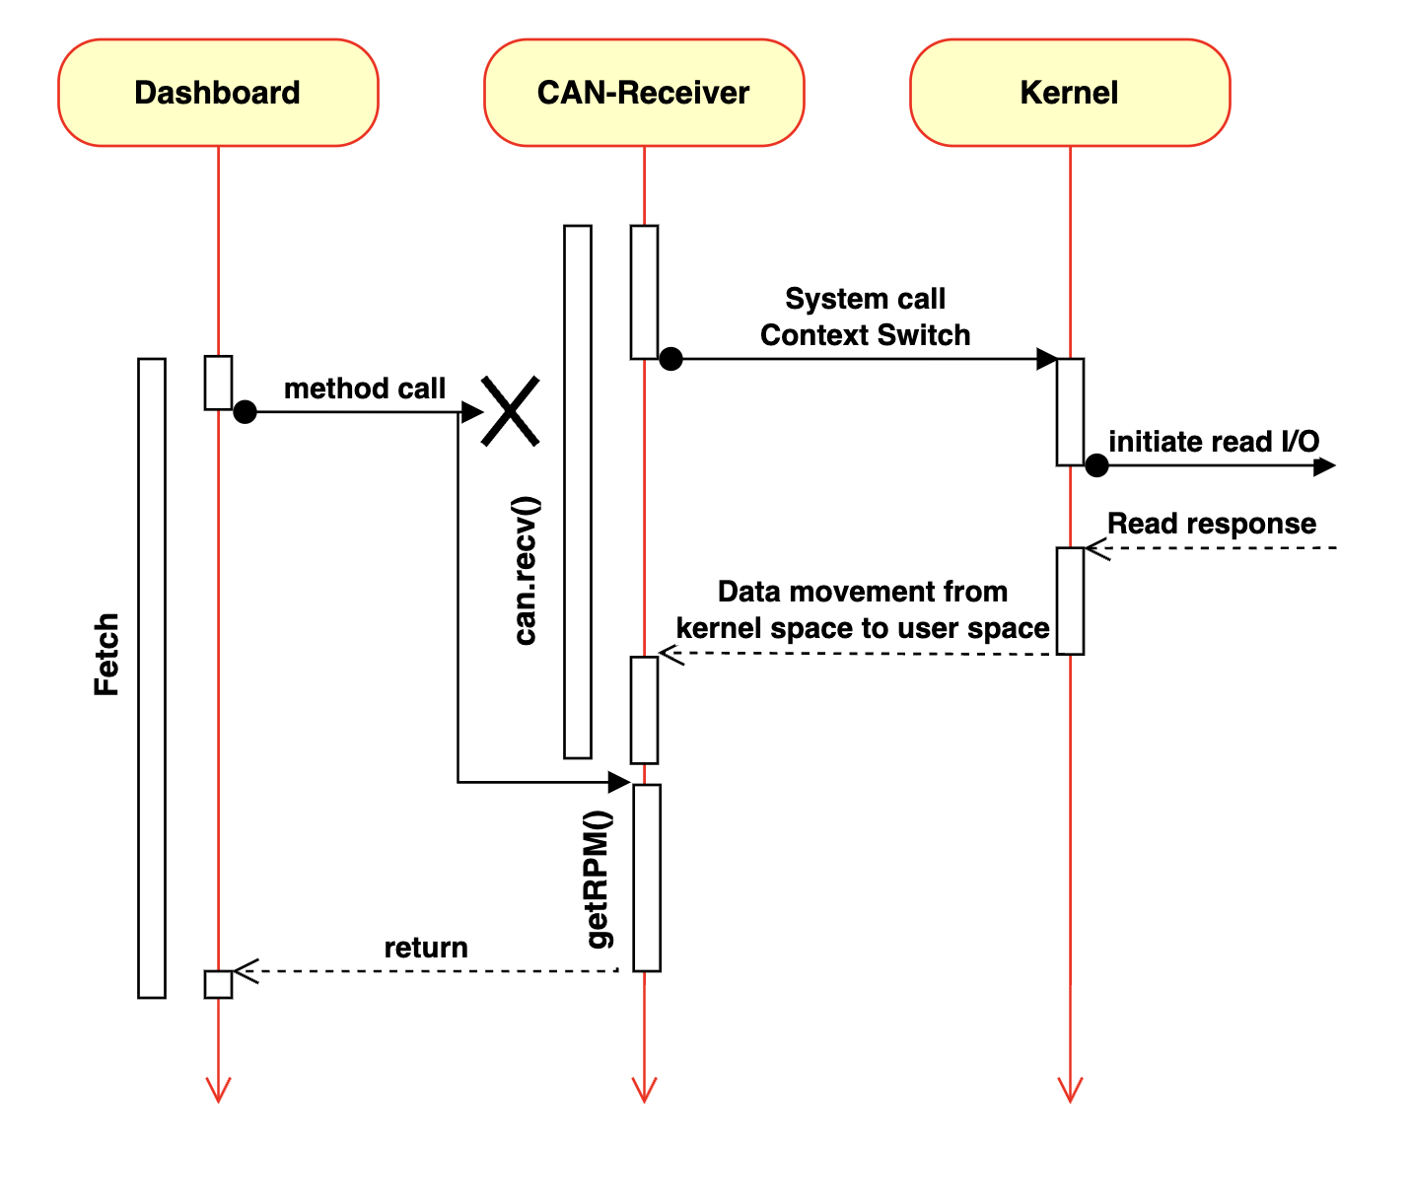
Blocking Problem
Thread can only handle
1 task at a time
Method call must wait until current task is done

Slide 12
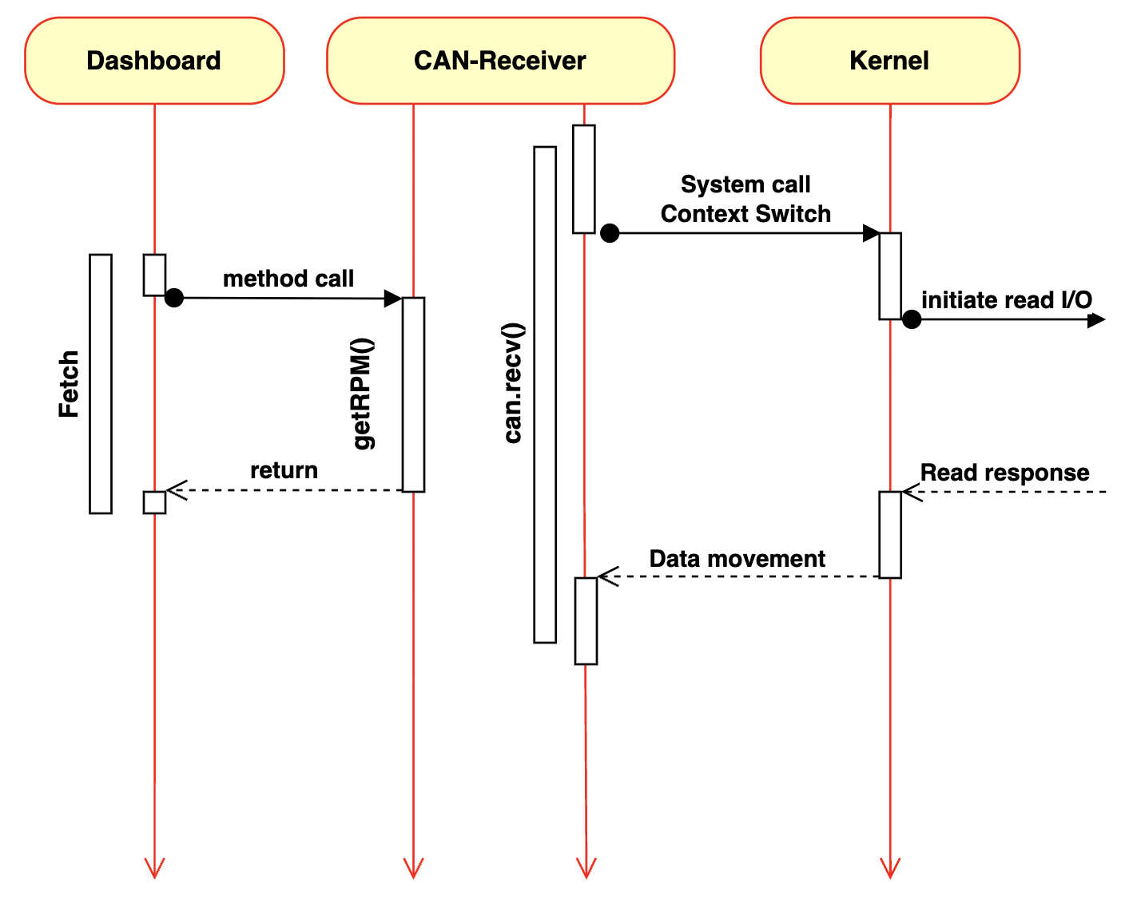
Using Multi Thread
Main thread can return
latest value immediately on request
Updating thread will update values periodically without blocking the main thread

Slide 13
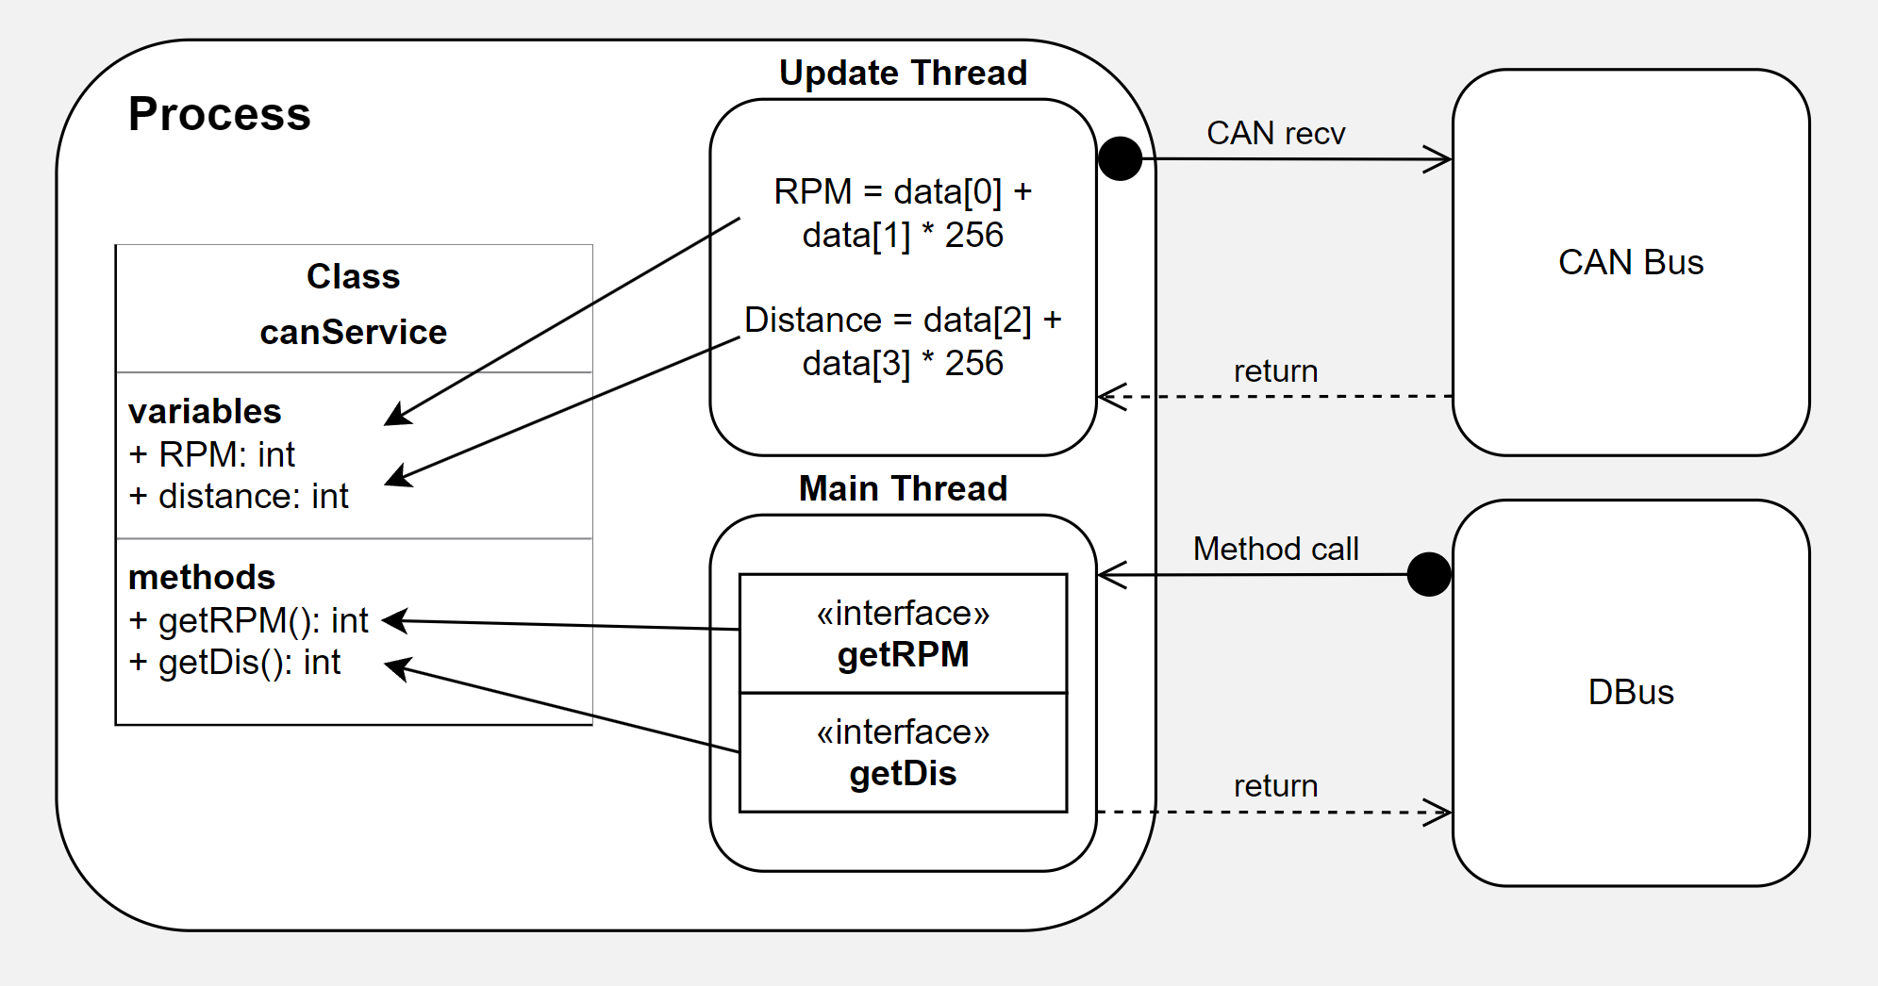
CAN-Receiver

Slide 14
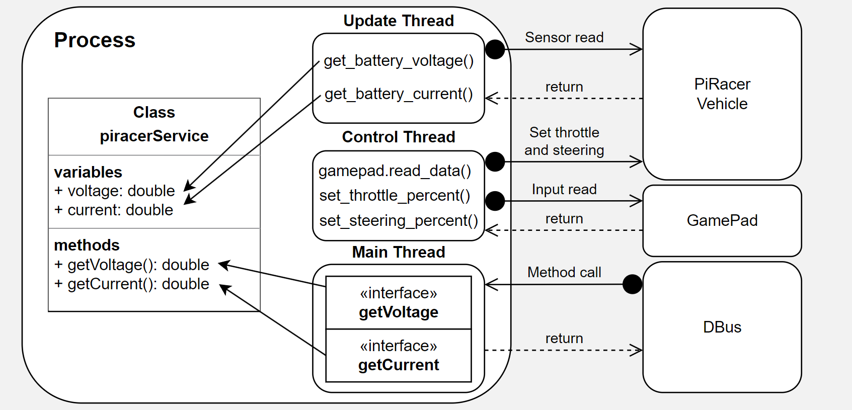
PiRacer

Slide 15
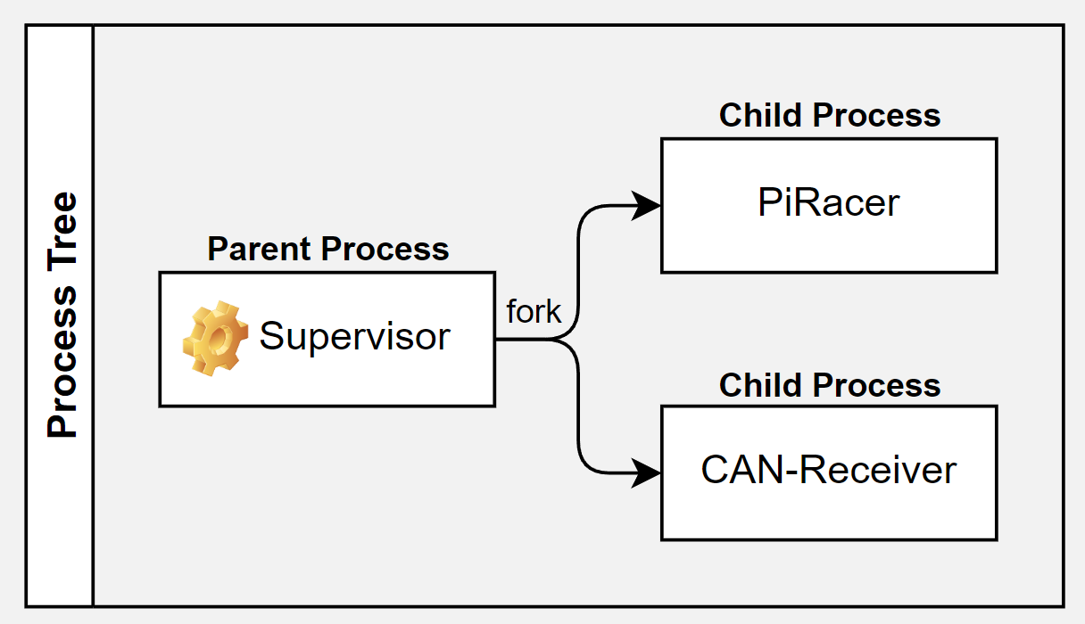
Adding Robustness
Auto starts at boot time
Parent process monitors children and can auto restart on child’s failure

Slide 16


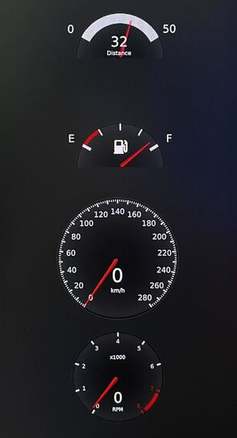
QT GUI Application
Features
Distance
Output rear Distance Data
Battery level
Output Battery Level
Speed
Output Current Speed
RPM
Output Current RPM

Slide 17

Flutter GUI Application
Features
Speed
Speed is indicated by
running speed of Nyan Cat
Battery
Battery level is represented on
top right side of the screen
Cute
Not Qt,
but Cutie

Slide 18
Live Demo

Slide 19
Conclusion
We have deep dived into both software and hardware
We have created responsive dashboard application by using multi threaded server
We have designed a software architecture that is easy to maintain and robust

Slide 20
Q&A

Slide 21
Thank you

